Slide 1
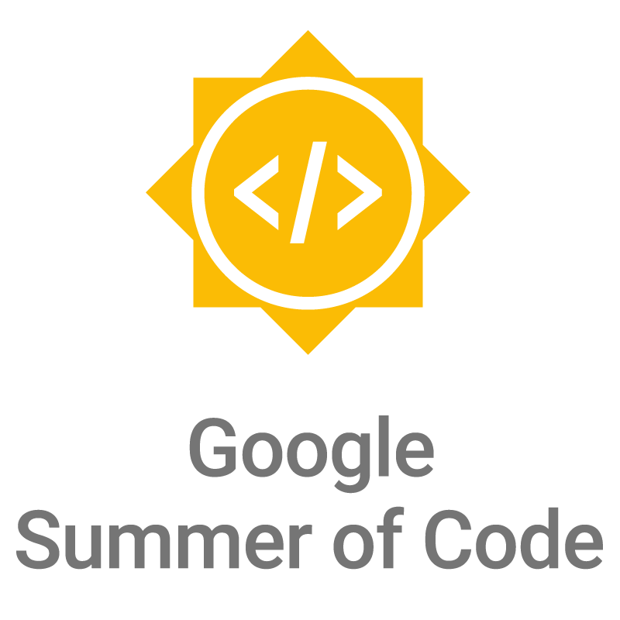

Slide 2
What is open source?
Computer software where the source code is distributed under an open source license that allows anyone to study, change, improve and distribute the software.
Promotes collaboration
Community of dedicated developers

Slide 3
What is GSoC?
Google Summer of Code (GSoC) is an online, international program designed to encourage university student participation in open source software development.

Slide 4
About
Students work for an open source software organization, and earn a stipend for successfully completing the project.
University students spend their time outside of school working in a field that can help them with their studies and career after university.

Slide 5
Goals of the program
  Motivate students to begin participating in open source development.
  Provide students in Computer Science and related fields the opportunity to do work related to their academic pursuits.
  Give students exposure to real-world software development scenarios (e.g., testing, version control, software licensing, mailing-list etiquette, etc.).
  Create more open source code.
  Help open source projects bring in new developers.

Slide 6
How does GSoC work?
Open source software projects apply to be mentor organizations
Google chooses the organizations to participate (206 in 2019)
Students submit project proposals to mentor organizations

Slide 7
How does GSoC work?
Mentor organizations choose the students they’d like to accept
Students are paired with a mentor to help them throughout their project
Coding begins! Students work towards milestones laid out in their project proposal with their mentor over 12 weeks

Slide 8
Evaluations
Students must pass three evaluations
Students who pass each evaluation are paid a stipend for their work
At the conclusion of GSoC, students submit the code they’ve written for their project for everyone to see and use!

Slide 9
Eligibility
Over 18 upon registration
Accepted into or enrolled in a university program by the student acceptance date
Eligible to work in the country in which you reside
Have participated in no more than 1 previous GSoC

Slide 10
Statistics
In 15 years 15,926 students from 109 countries have been accepted into GSoC
Countries with the most students:
  India (4,065), United States (2,552), and Germany (870 )
Approximately 36+ million lines of code have been produced

Slide 11
Useful links
Program Site: http://g.co/gsoc
Student Guide: http://g.co/gsoc/resources/guide
Google Open Source Blog: https://opensource.googleblog.com/

Slide 12
2020 Program Timeline
January 14 Organization applications open
February 20 Accepted GSoC Organizations announced
March 16-March 31 Students submit their proposals
April 27 Accepted students are announced
April 27-May 18 Community bonding period with orgs
May 18-Aug 17 Students code the summer away
August 25 Successful student projects are announced

Slide 13
Questions?

